Slide 1
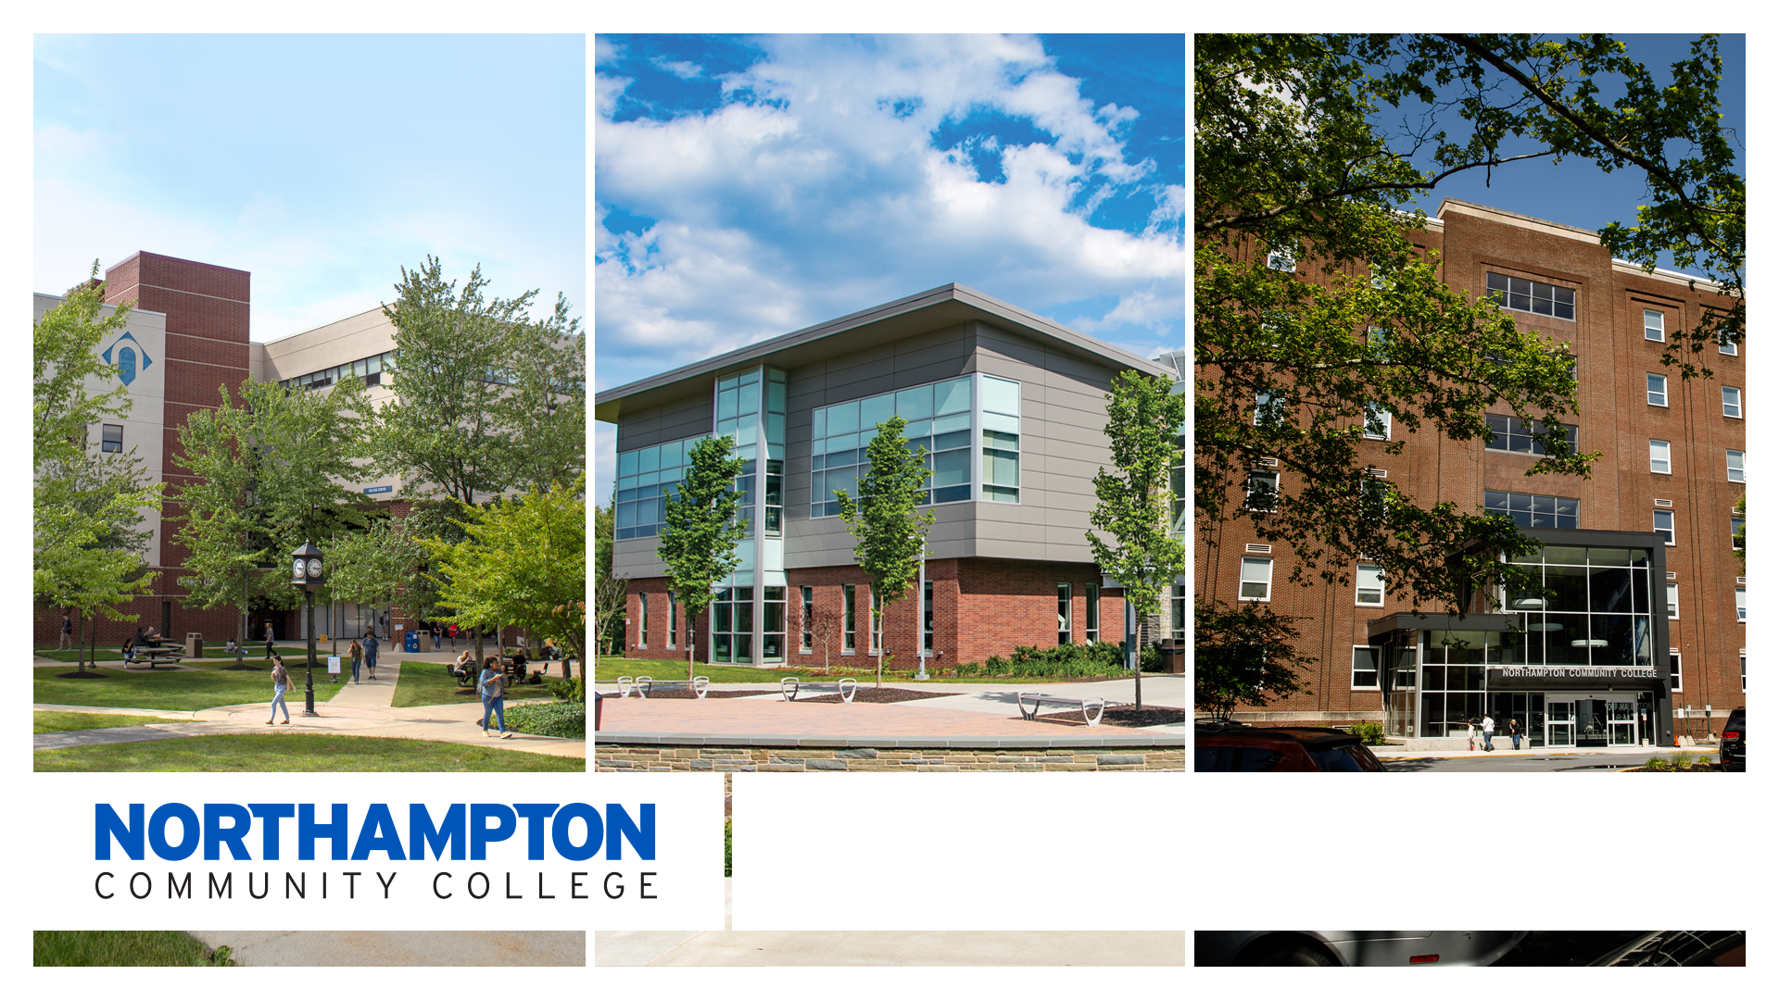

Health Sciences, AAS

Slide 2

Health Sciences, AAS
62-64 credits
4 semesters
Some classes are online others in person
Gives students overview of Healthcare field
Good option for students who do not get accepting into other AAS programs (ie: Nursing, etc.) who are interested in the Health field.

Slide 3
Health Sciences @ NCC
The AAS in Health Sciences program will give you a broad understanding of the healthcare system.
With this coursework, you will establish a framework of the human body by studying:
  Biology
  Public Health
  Chemistry
  Psychology

Slide 4
Employment in Health Sciences
You’ll be prepared to start your career immediately after graduation in entry level Health Science positions
Examples include:
  Community Health Worker
  Health Coach
  Healthcare Administration
  Medical or Pharmaceutical Sales
  Other health-related services

Slide 5
Furthering Your Education
Building off your AAS in Health Sciences degree, you can continue on to:
  A four-year institution to pursue a bachelor’s degree in areas such as:
    Exercise Science
    Health Communication
    Health Administration
    Public Health
    “Pre” Degrees such as medicine, dentistry, physical therapy, occupational therapy, pharmacy

Slide 6
Health Sciences, AAS Resources
  Direct Link to Health Sciences Website:
    https://www.northampton.edu/health-sciences.htm

Slide 7
Program Contact Information
Program Name | Contact Name | Email
Dental Hygiene | Sherri Meyers | Smeyers@Northampton.edu
Emergency Services Technology | Tom Barnowski | Tbarnowski@Northampton.edu
EMT/EMR | John Evans | Jevans@Northampton.edu
Funeral Services | Tony Moore | Tmoore@Northampton.edu
Medical Assistant | Karen Stone | Kstone@Northampton.edu
Nursing (RN, LPN) | Thomas Rush | Trush@Northampton.edu
Public Health | Alyson Patascher | Apatascher@Northampton.edu
Radiography | Tracey Lenhart | Tlenhart@Northampton.edu
Sonography | Susan Davidson | Sdavidson@Northampton.edu
Sports Medicine & Rehabilitation Services | James Reidy | Jreidy@Northampton.edu
Veterinary Technician | Lisa Martini-Johnson | Lmartini-Johnson@Northampton.edu

Slide 8
We Are Here To Help!
Contact any of us with questions about NCC’s Health Sciences Program:
Alyson Patascher: Associate Dean, School of Health Sciences and Education / Health Sciences Program Manager
  apatascher@northampton.edu
Virginia Coleman: Associate Director, Advising and Transfer Services
  vcoleman@northampton.edu
Rachel Stumpp: Academic Advisor
  rstumpp@northampton.edu

Slide 9

Questions?
  Alyson Patascher, MPH
  apatascher@northampton.edu

