Slide 1
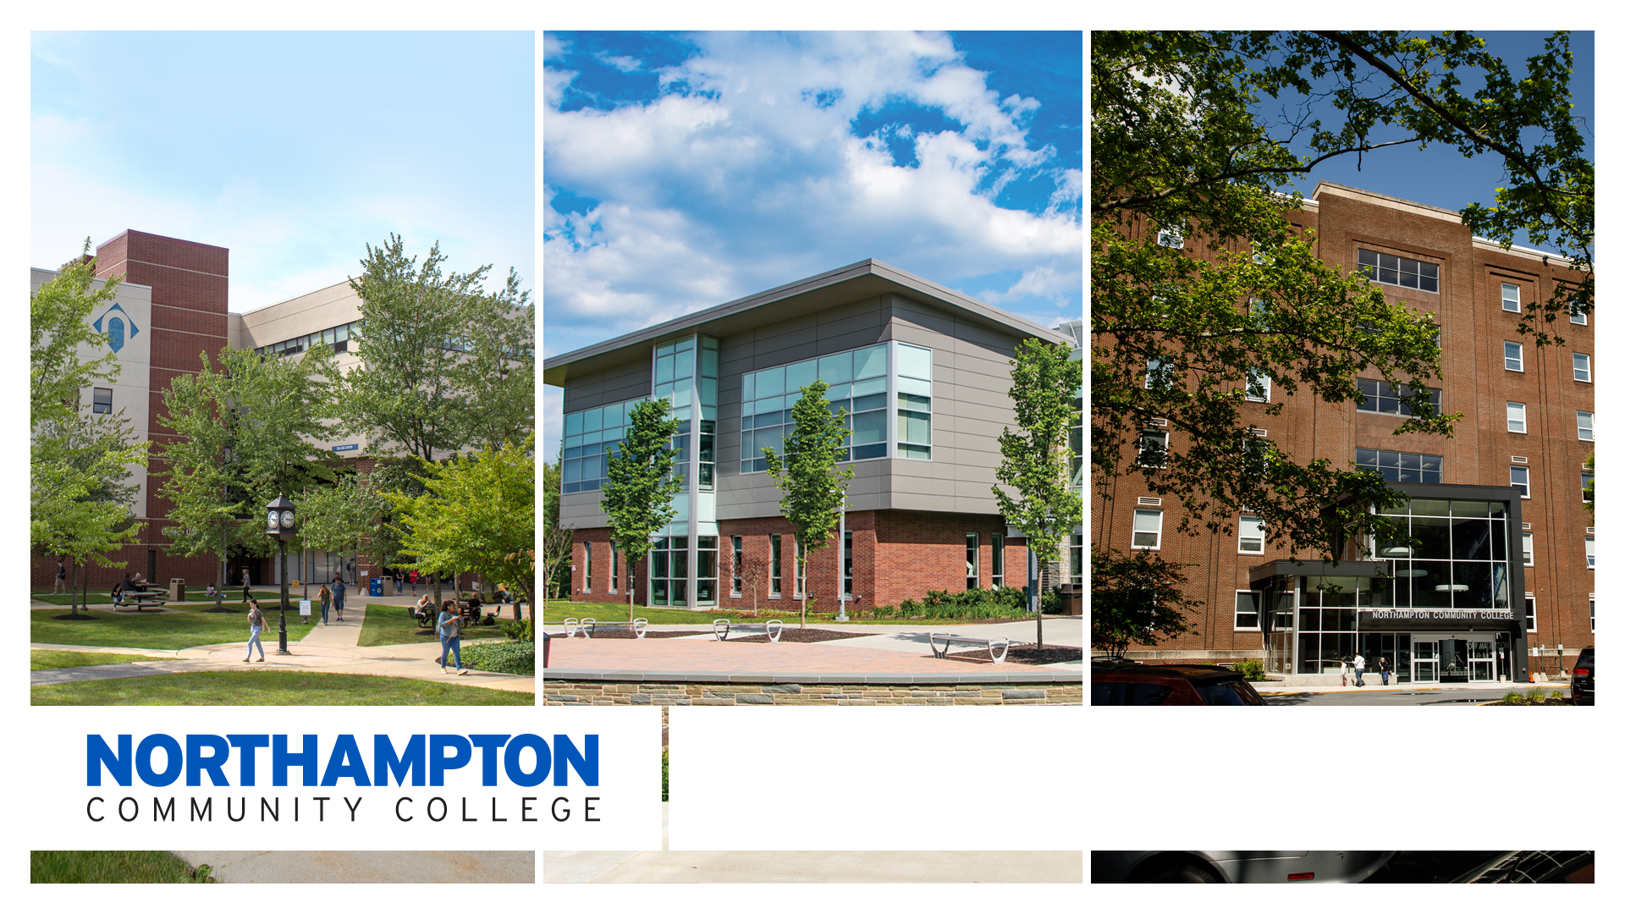

School of Health Science, and Education
Program Orientation

Slide 2


WELCOME AND CONGRATULATIONS!
Dr. Judy Rex
Dean of School of Health, Science, and Education
Congratulations on your acceptance into a highly competitive program!
JR

Slide 3


WELCOME…
Alyson Patascher, MPH, TTS
  Associate Dean of School of Health, Science, and Education
AP

Slide 4

WELCOME…
Shawn Fortley
  Healthcare Records Coordinator, School of Health, Science and Education
SF

Slide 5
OVERVIEW OF TODAY’S ORIENTATION
    PA AHEC Scholars Program
    Accessing Public Benefits
    Disabilities Services
    The Libraries
    Residence Halls
    Academic Life After COVID-19
    NCC Text Alerts
    NCC-Go App
    Class Schedules
    Admissions Office
    Advising and Registration
    Health Science Resource Webpage
    Health Form Overview
    myRecordTracker®
    Program Orientations
JR

Slide 6

PA AHEC SCHOLARS PROGRAM
Leslie Petroff, Eastcentral PA Area Health Education Center (AHEC)
AHEC Scholars is a FREE two-year nationally recognized certificate program focusing on rural and/or underserved urban healthcare
Each year includes the following:
40 hours community-based, experiential, or clinical training
40 hours didactic education (interactive, online)
Benefits:
Standout Resume
Interprofessional Experience
Clinical & Community/Research Experience
Supplemental Training Experiences
Networking & Career Advancement
Virtual Information Sessions
Visit
www.paahecscholars.org
For more information
on the next session!
www.paahecscholars.org
JR

Slide 7
ACCESSING PUBLIC BENEFITS
Maryann Haytmanek – Director of Spartan Aid, KEYS, and New Choices
mhaytmanek@northampton.edu or 610-861-4555
  Culture of Caring: https://www.northampton.edu/you-matter-at-ncc.htm
  KEYS: provides additional benefits for most students who receive TANF (cash assistance) or SNAP (Food Stamps)
  SpartanAid: provides emergency assistance for students with non-academic emergencies with referral to on-and-off campus resources and occasionally with direct assistance
JR

Slide 8
DISABILITY SERVICES
Reasonable and appropriate accommodations may be provided to students with disabilities and are determined on a case-by-case basis, which can include the following:
    Assistive Technology
    Textbooks in Alternate Format
    Note-taking assistance
    Recording Lectures
    Test Accommodations
    Sign Language Interpreters
    Specialized Academic Advisement
More information can be found at: https://www.northampton.edu/disabilityservices
JR

Slide 9

THE LIBRARIES
Evonne Loomis – Acquisitions Librarian, Library Resources
  Services
  Research Tools
  More than Books!
  Questions?
    Library Website: https://northampton.edu/library.htm
    Library Email: eloomis@northampton.edu
JR

Slide 10
RESIDENCE HALLS
Housing Applications
Residence Living after COVID-19
    Although COVID-19 and Flu vaccinations are strongly recommended for living in the Residence Halls, both are still mandatory for programs with a clinical component (such as Medical Assistant, Nursing, Radiography, Respiratory, Sonography, etc.)
SEPARATE myRecordTracker Account – Requirements must be complete to move in!
https://www.northampton.edu/campus-life/housing-and-residence-life.htm
Contact Residence Life at ResidenceLife@northampton.edu
JR

Slide 11
ACADEMIC LIFE AFTER COVID-19
What will the future look like?
  Online classes, on-campus classes, hybrid classes – mixture of all?
  Social/spatial distancing of students in classroom
  Facemasks optional, but must keep one with you and be considerate of faculty, staff, and other students – wear if asked
  Cleaning and sanitizing - ongoing
JR

Slide 12
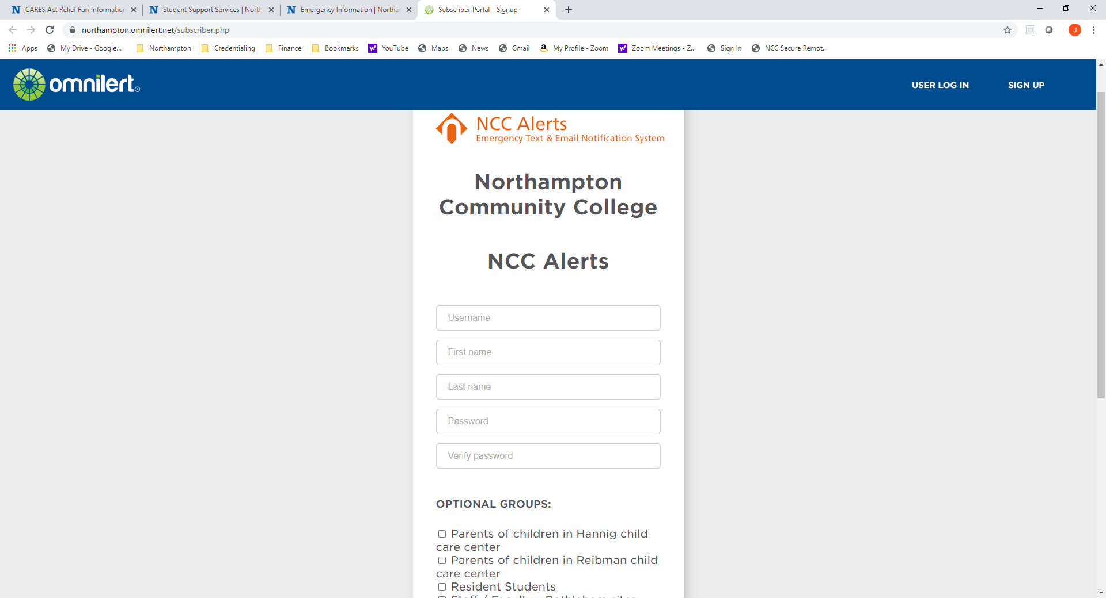
NCC TEXT ALERTS
Sign up for Emergency Text Alerts at:
  https://northampton.omnilert.net/subscriber.php
  Weather Alerts
  Campus Emergencies
  College Closing Information
  Child Care Information
  Residence Students
AP

Slide 13
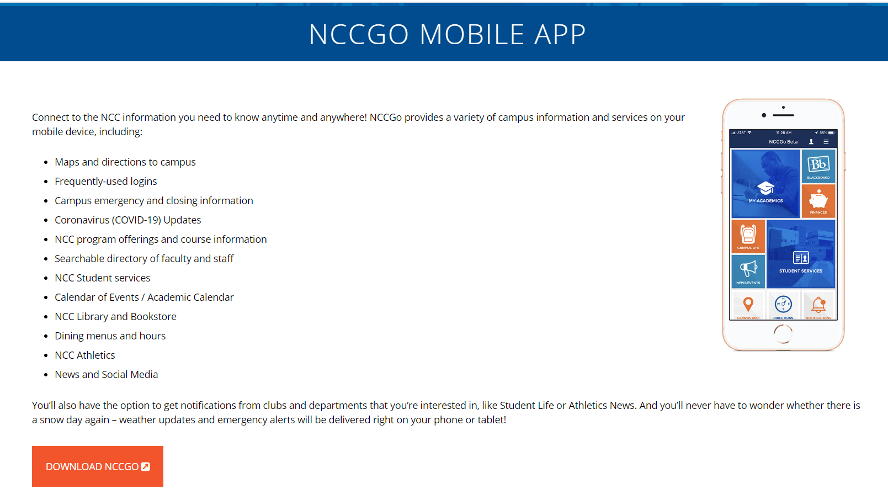
https://www.northampton.edu/nccgo.htm
AP

Slide 14
CLASS SCHEDULE
What will the class schedule look like?
  Online Classes – Synchronous and Asynchronous
  Hybrid with Lab Component – Lectures Online and Labs On-Campus
  On-Campus Classes – Combination of Remote and On-Campus
  On-Campus Classes – Completely On-Campus
  Check your schedule for Changes in Dates and Times!
AP

Slide 15
ADMISSIONS OFFICE
Robert McGann, Associate Vice President Enrollment Services
  Conditional Students
    Must meet conditions/requirements of all courses in progress
  Final Transcripts
    If finishing classes at another school, please be sure to send your final transcripts to the processing center at NCC
  Contact Admissions at adminfo@northampton.edu
SF

Slide 16
ADVISING AND REGISTRATION INFORMATION
David Repyneck– Advisor for Health Science Programs/Majors (drepyneck@northampton.edu)
Virginia Coleman – Associate Director of Advising and Transfer (vcoleman@northampton.edu)
  https://nacc.sharepoint.com/sites/WorkdayStudentSystem
  https://www.northampton.edu/links.htm
  https://www.northampton.edu/workday-faq.htm
AP

Slide 17
HEALTH SCIENCE RESOURCES WEBSITE
https://www.northampton.edu/health-science-resources.htm
Acceptance Checklists for each Program/Major
  Recorded PowerPoints for further clarification on Acceptance Checklists including background clearances, health requirements, and myRecordTracker®
  Essential Functions for each Program
  Health Forms and OSHA Form
  Resource Links for BLS, Disability Services, Health Center, Workday
JPB

Slide 18
HEALTH FORM OVERVIEW
Tracy Newman – RN, NCC Health & Wellness Center
  Physical Exam
  Immunization Records
  Titers
  TB Testing
https://www.northampton.edu/campus-life/health-and-wellness-center.htm
NCC Health and Wellness Center
Main Campus
College Center 120
610-861-5365
HealthCenter@northampton.edu
JPB

Slide 19

myRecordTracker®
Invitation email will come from myrecordtracker@verticalscreen.com
Check Spam Folder
You may not receive your invitation for up to 2-3 weeks after you receive your acceptance letter! Please be patient! After 3 weeks, contact your Program Director.
Troubleshooting: Shawn Fortley, Healthcare Records Coordinator - sfortley@northampton.edu
    Background Clearances
    myRecordTracker Questions
    Uploading Concerns
JPB

Slide 20
Background Clearances
There are three background clearances needed for most programs
  PA State Police (PATCH) – Cost $22.00 – DO NOT DO VOLUNTEER VERSION
  FBI Fingerprinting – Cost $25.25
  Child Abuse Clearance – Cost $13.00
Read important instructions related to background clearances if there is something in your past history
Contact your Program Director as soon as possible to discuss further steps
JPB

Slide 21
Verification of Residency
You will be required to complete a Verification of Residency Form
  List current address and any other addresses for the past 2 consecutive years
  Provide copy of State-Issued Driver’s License or Photo ID
If you have not lived in Pennsylvania for the past 2 consecutive years, you will be required to obtain another FBI Clearance through the PA Department of Aging
  Cost, if needed, is $25.25
JPB

Slide 22
Program Orientation and Registration
Program Orientation is mandatory!
Check your Acceptance Checklist for your program’s Orientation details
Mark the date, time, and room location on your calendar
Registration will take place the day of orientation
Nursing students: Registration opens one week AFTER Orientation
AP

Slide 23


REMINDER…mark the calendar for the Program Orientation & Registration
JR

Slide 24

wishes you success!

