Slide 1


ACCEPTANCE CHECKLIST INSTRUCTIONS

Slide 2

YOU’VE BEEN ACCEPTED!
Next Steps:
    Watch the Health Career Orientation Zoom
    Access and download the Acceptance Checklist located under your Health Career Program heading
    Remember to print it one-sided so that all the pages will print correctly for future uploading

Slide 3
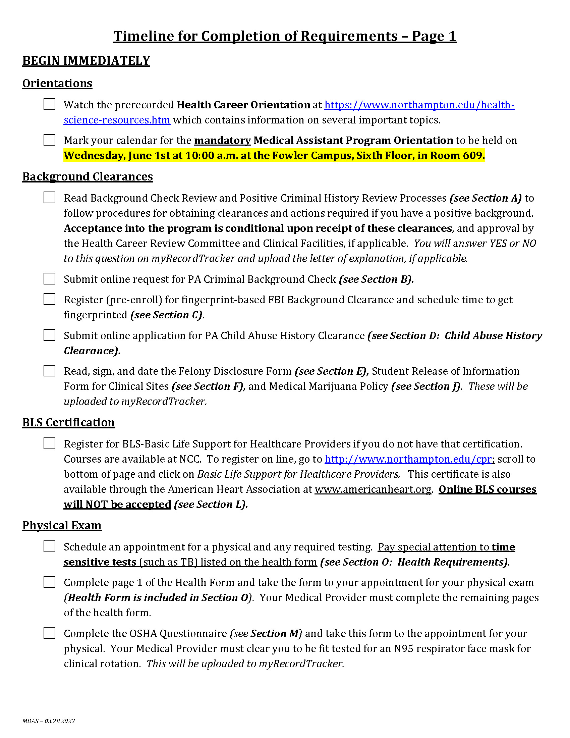
ACCEPTANCE CHECKLIST
The Acceptance Checklist has been designed as a tool to guide you through the many steps and requirements you need to follow to be successful
It is set up in date order for your convenience
Your checklist is based on your program so it may differ from what we discuss today, so follow specific requirements and specific due dates on your Acceptance Checklist only!

Slide 4
ACCEPTANCE CHECKLIST
Most programs require background clearances
Acceptance is conditional upon receiving all criminal history clearances if required for your program
Health Requirements may include:
    Physical and Immunizations
    Health Insurance
    COVID-19 Vaccination
    Urine Drug Screen

Slide 5
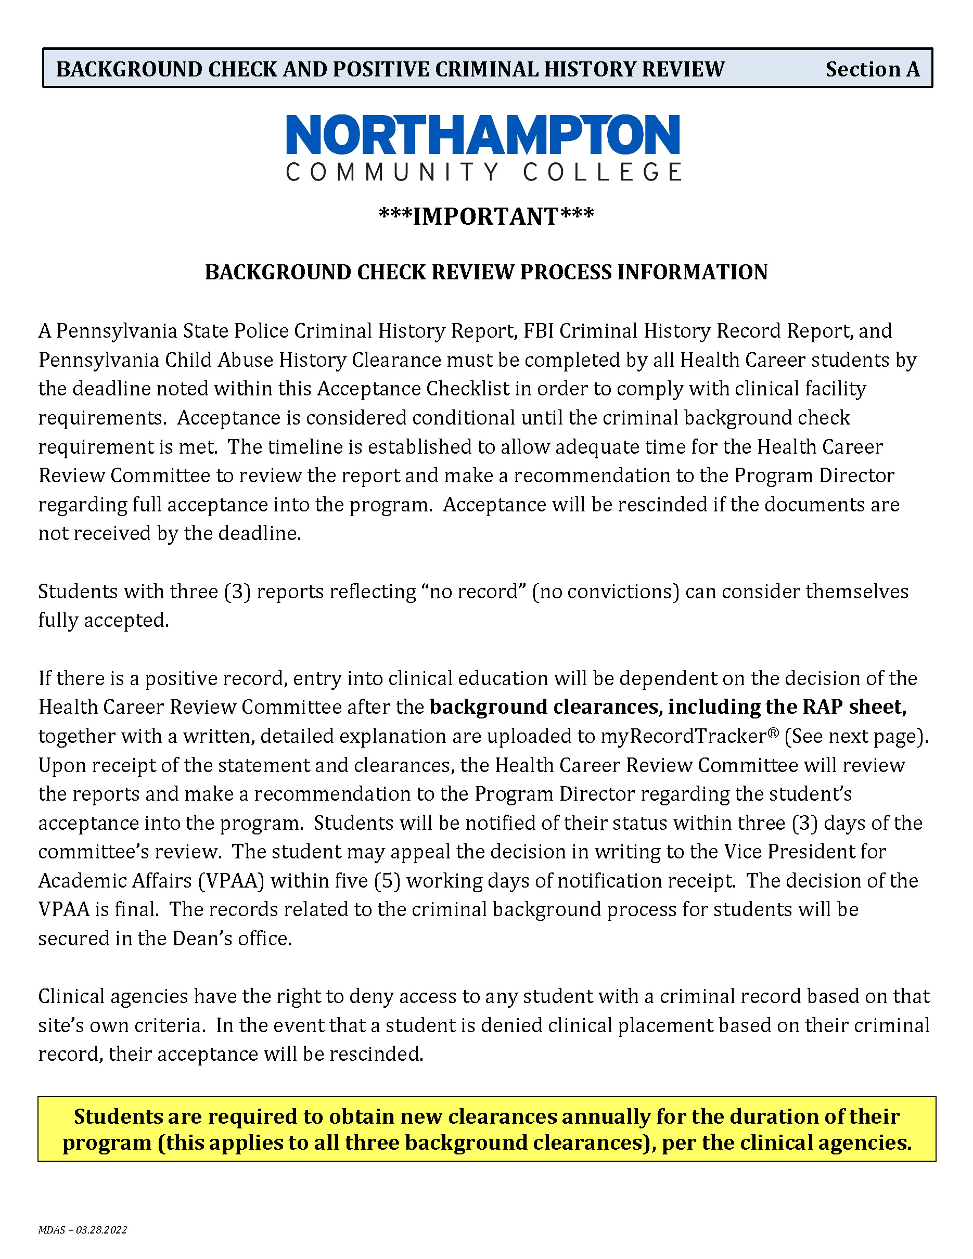
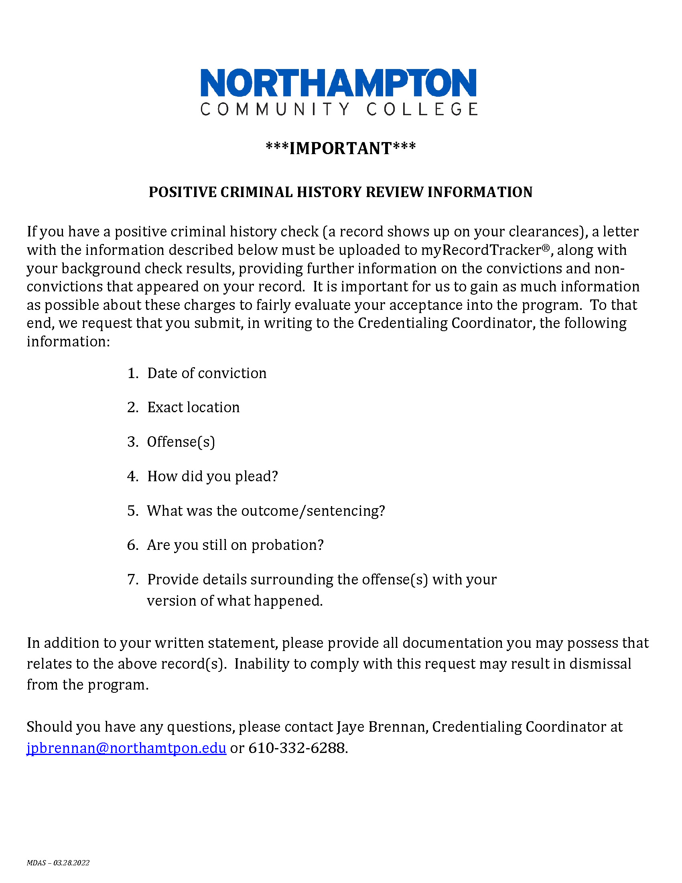
BACKGROUND CHECK REVIEW
If something may show up on your clearances, notify your Program Director or Credentialing Coordinator
On myRecordTracker® you will answer “yes” and upload the letter of explanation if needed
Committee will review and send letter of approval or denial
Remember that clinical facility must also approve clearances

Slide 6
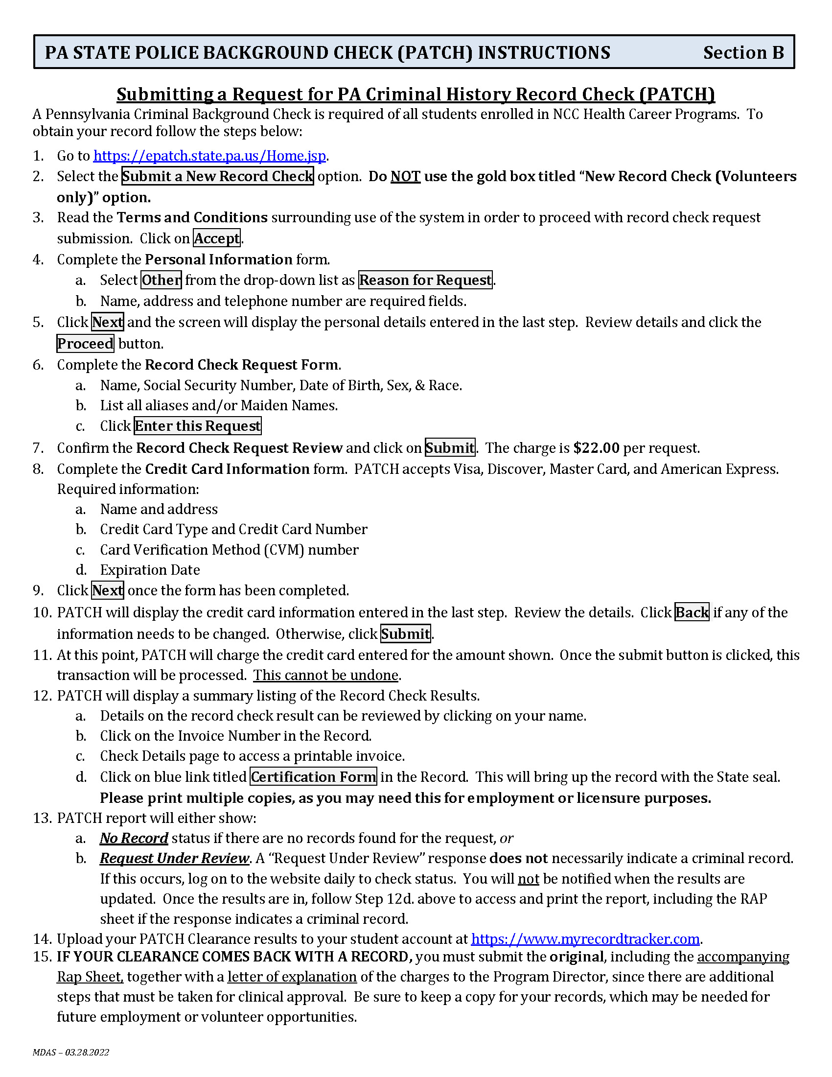
PA RECORD CHECK (PATCH)
Cost is $22.00
Upload to myRecordTracker.com
Submit original document to Program Director, if required
If not done yet, must be completed and uploaded by due date in order to remain accepted into your program!

Slide 7
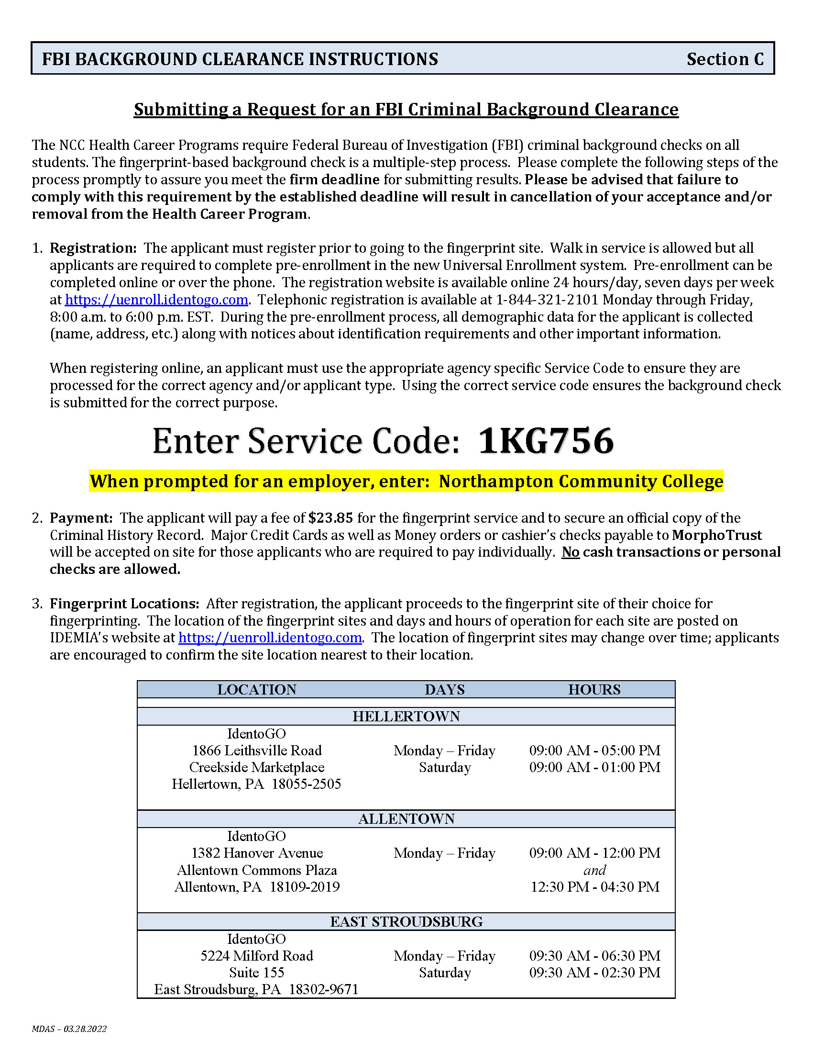
FBI CLEARANCE
Pre-Enroll at uenroll.identogo.com
Enter Service Code 1KG756
Cost is $25.25
Schedule appointment or check walk-in
Print pre-enrollment receipt to take to the IdentoGO location for fingerprinting
Bring appropriate documentation!
Will receive email to download and print clearance if no record.
If there is a record, it will be mailed.
Upload to myRecordTracker.com - AND - submit original document to Program Director, if required

Slide 8
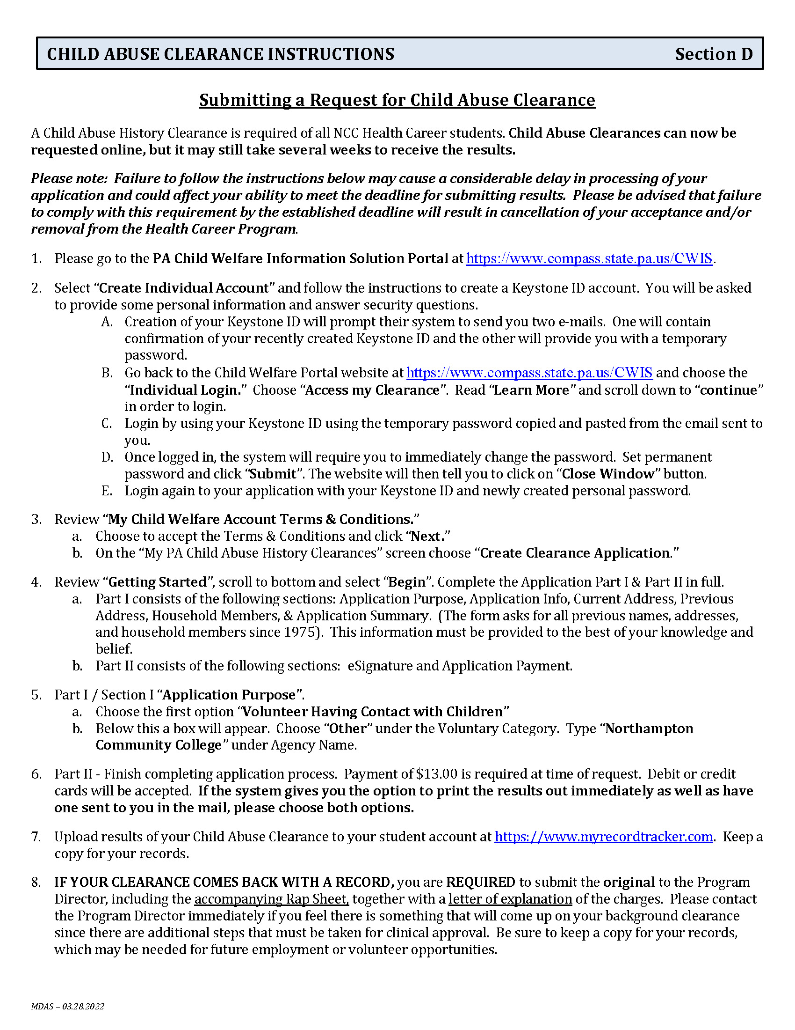
CHILD ABUSE CLEARANCE
Follow instructions closely and be very specific with details of who you have lived with since 1975
Choose online and by mail options
Cost is $13.00 (which may be waived)
Upload to myRecordTracker.com
Submit original document to Program Director, if required

Slide 9

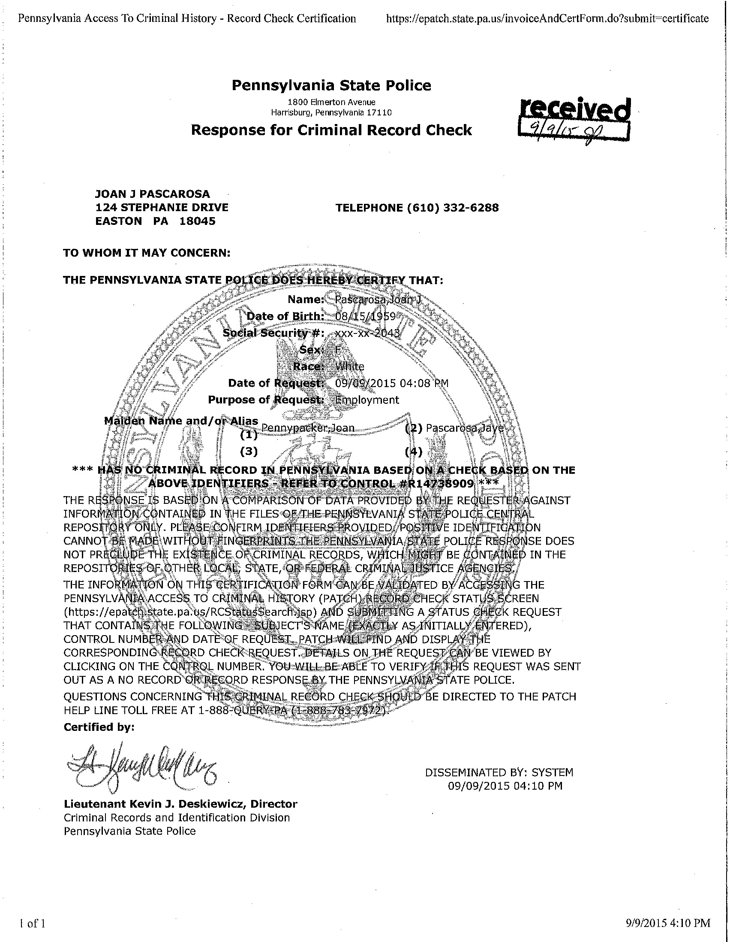
CONDITIONAL ACCEPTANCE
Acceptance is considered conditional until receipt/upload of all three background clearances (PATCH, FBI, and Child Abuse)
ALL pages of each background clearance must be uploaded, including any RAP Sheet pages if applicable
JESSICA X. SAMPLE
123 ANYWHERE DRIVE
BETHLEHEM, PA 18020
NOPE, JESSICA
TRIAL, JESSICA
ERROR, JESSICA

Slide 10
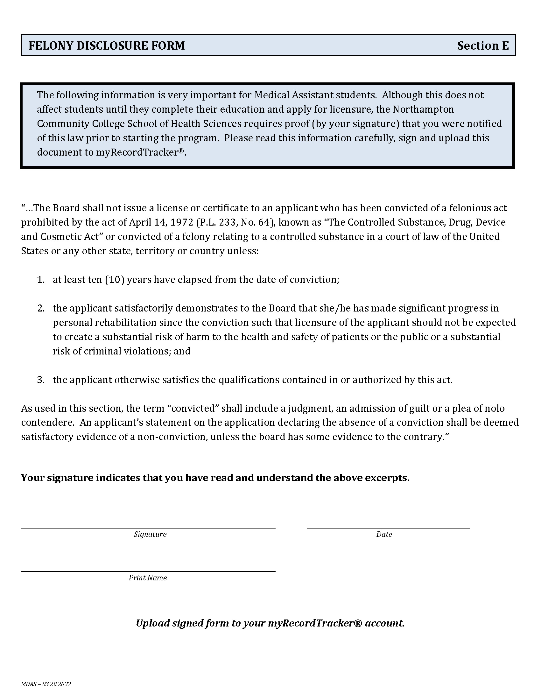
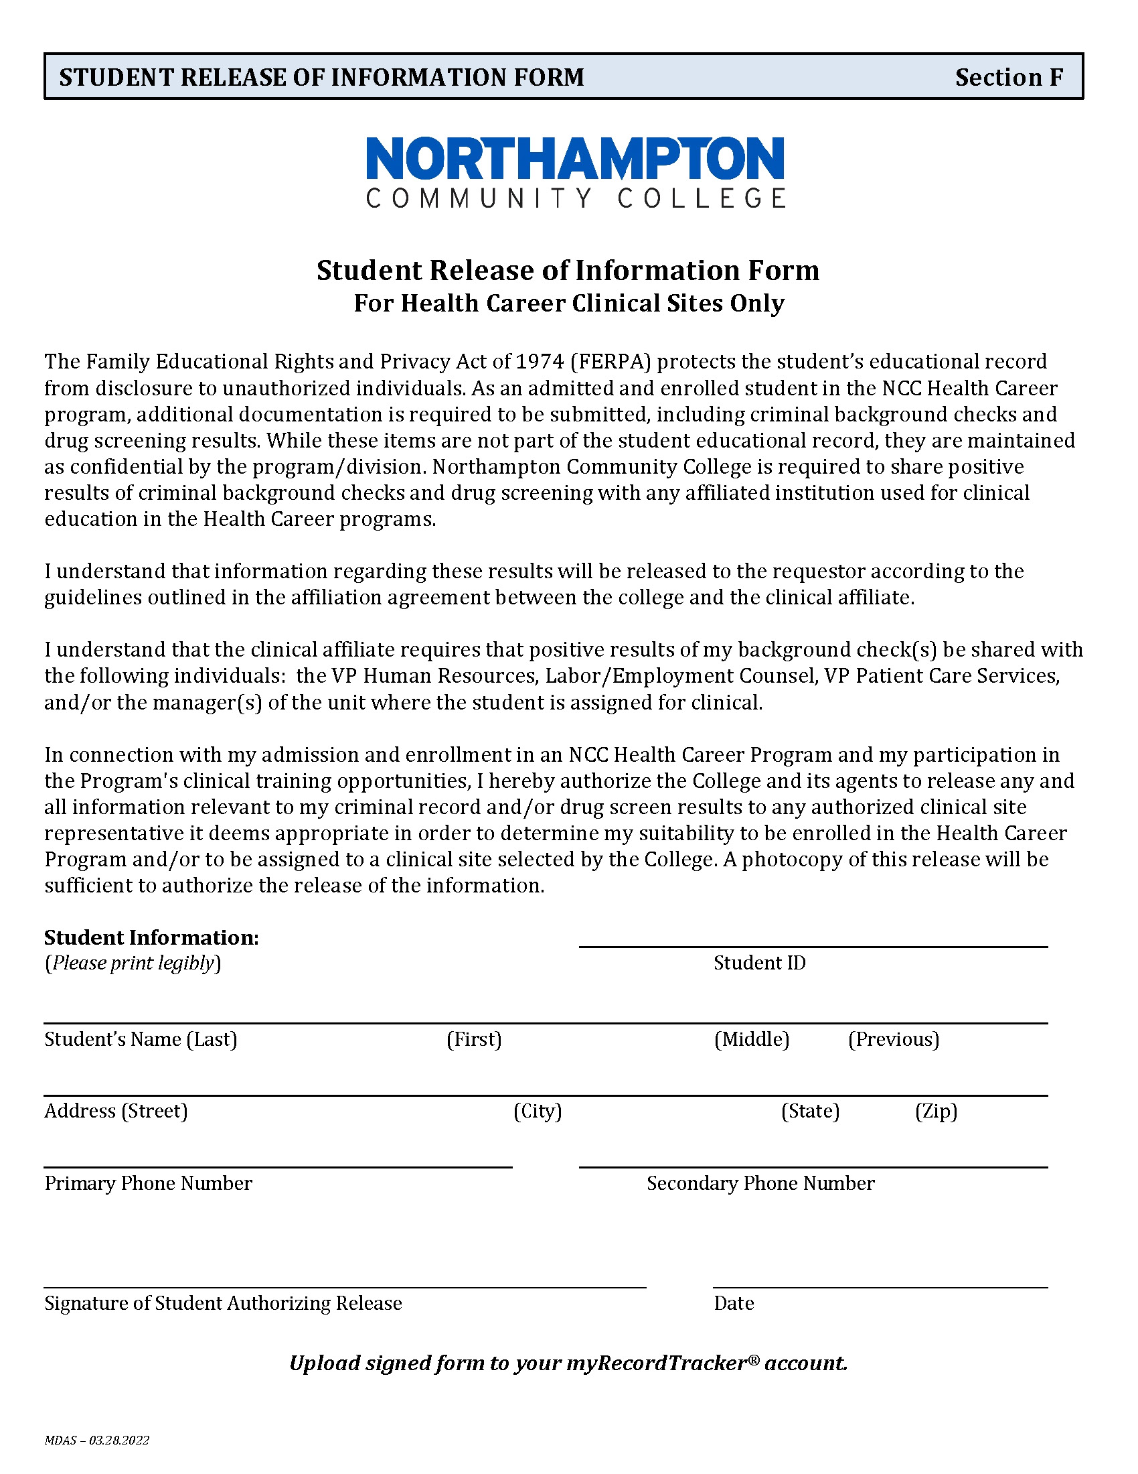
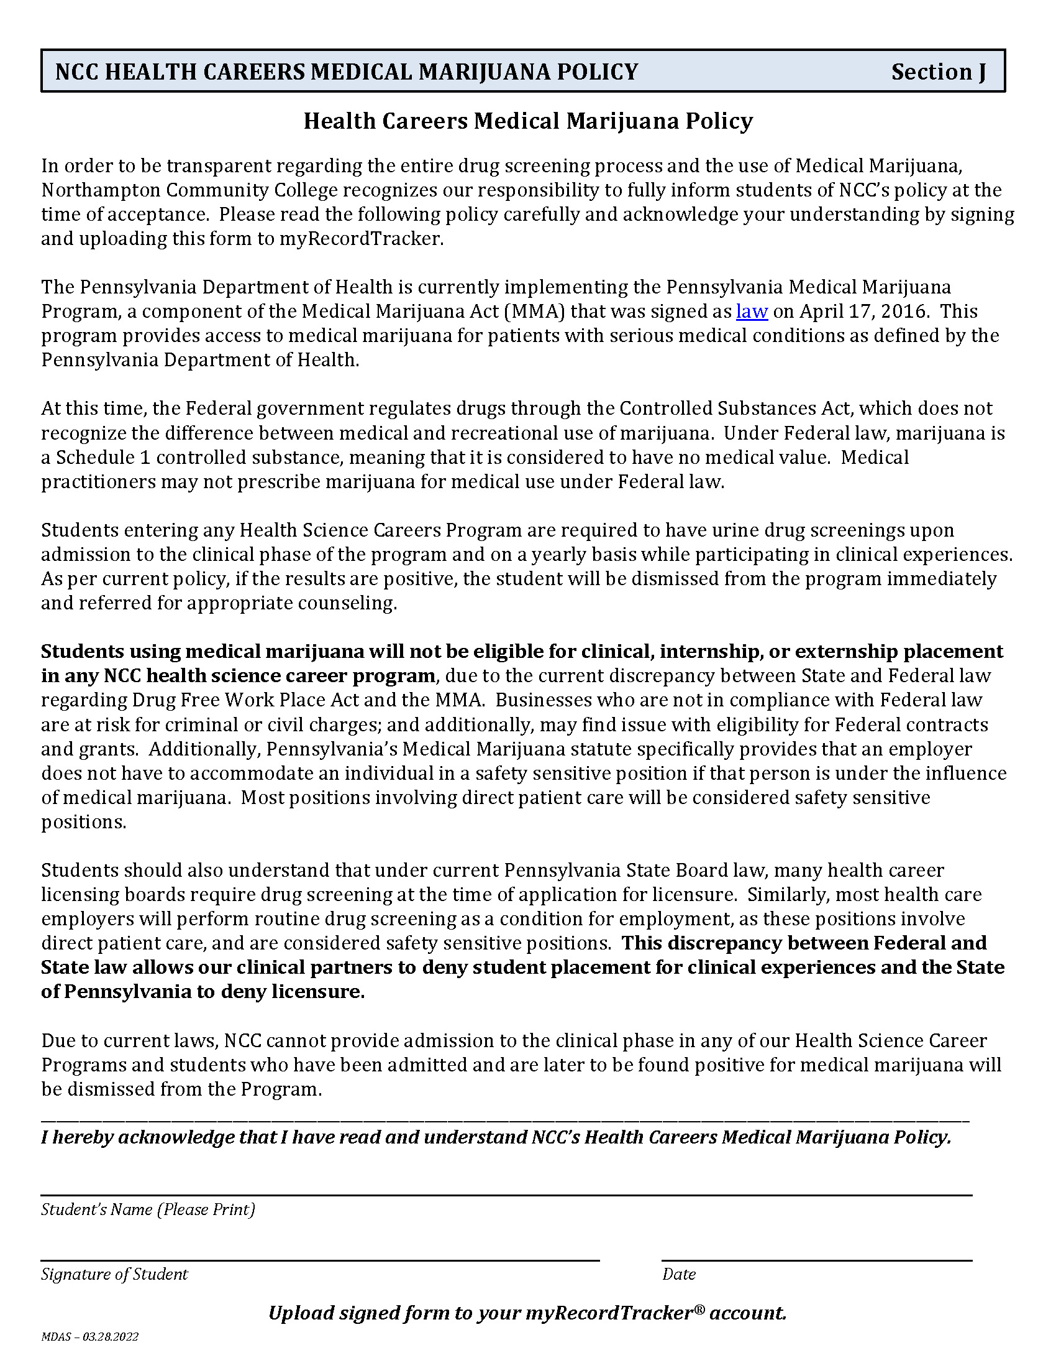
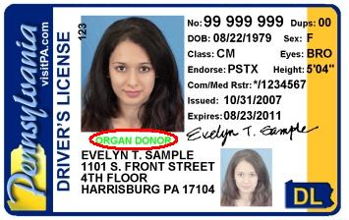
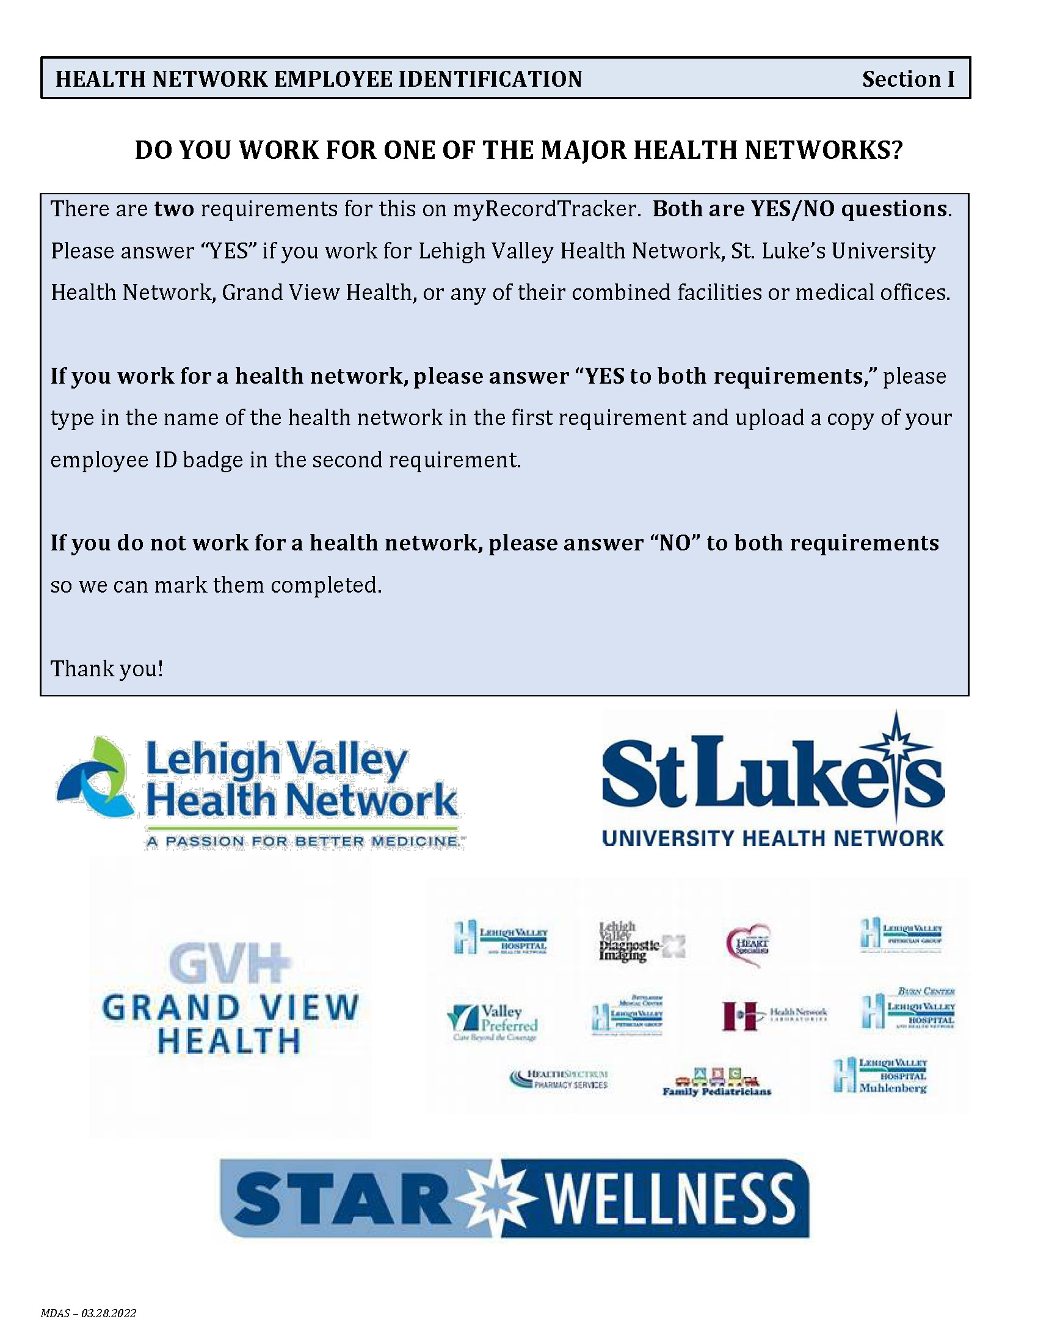
ADDITIONAL REQUIREMENTS
Upload any additional forms and documents listed in your Acceptance Checklist to myRecordTracker.com including:
    Felony Disclosure Form
    Medical Marijuana Policy
    Student Release of Information For Health Career Clinical Sites
    Photo Identification and/or NCC Student ID
    Health Network Employee Identification

Slide 11
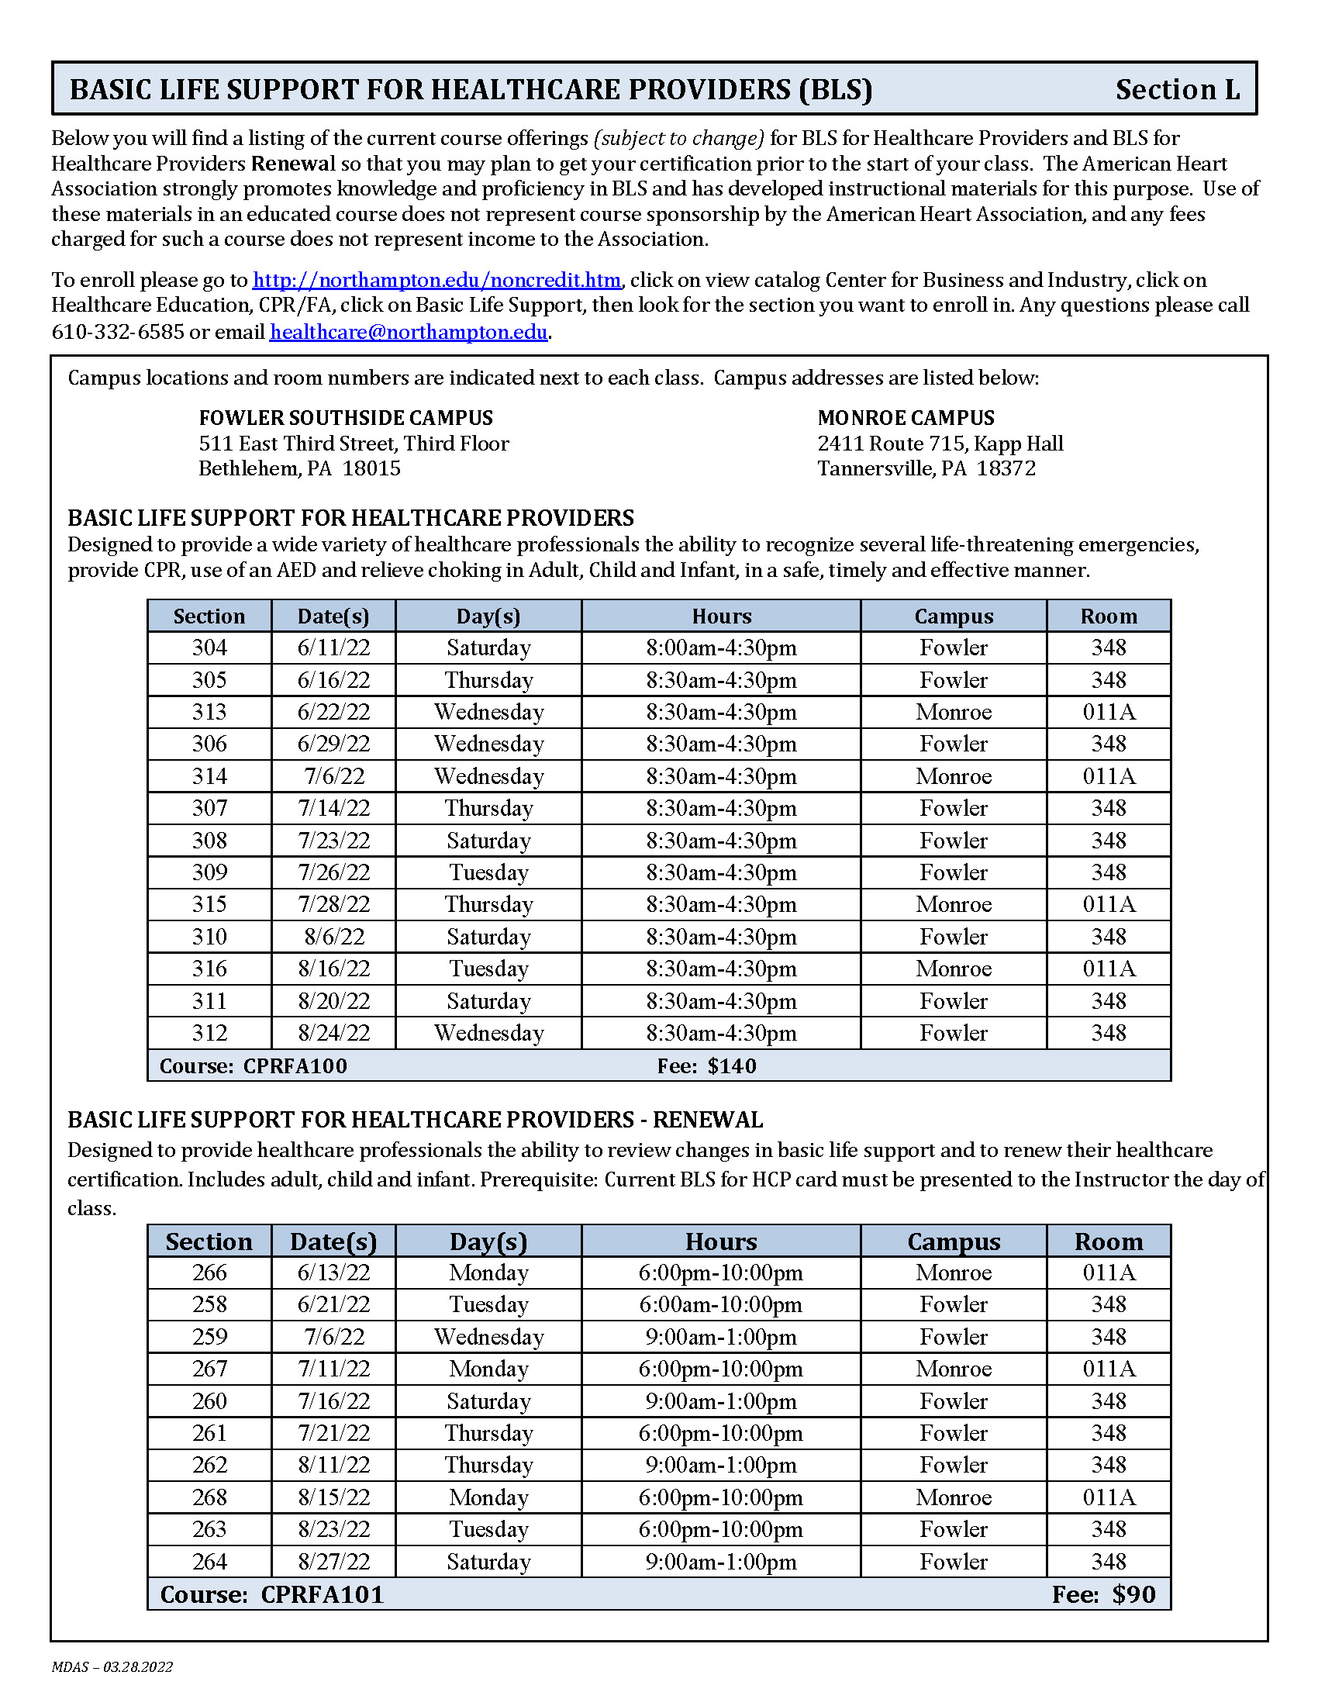
BLS for Healthcare Providers
Course must be Basic Life Support for Healthcare Providers (not CPR/AED and NO ONLINE COURSES!)
Schedule of available classes included for your convenience at NCC’s Fowler and Monroe Campuses
Must be completed by due date listed for most programs
Upload copy of BLS Certificate to myRecordTracker.com

Slide 12
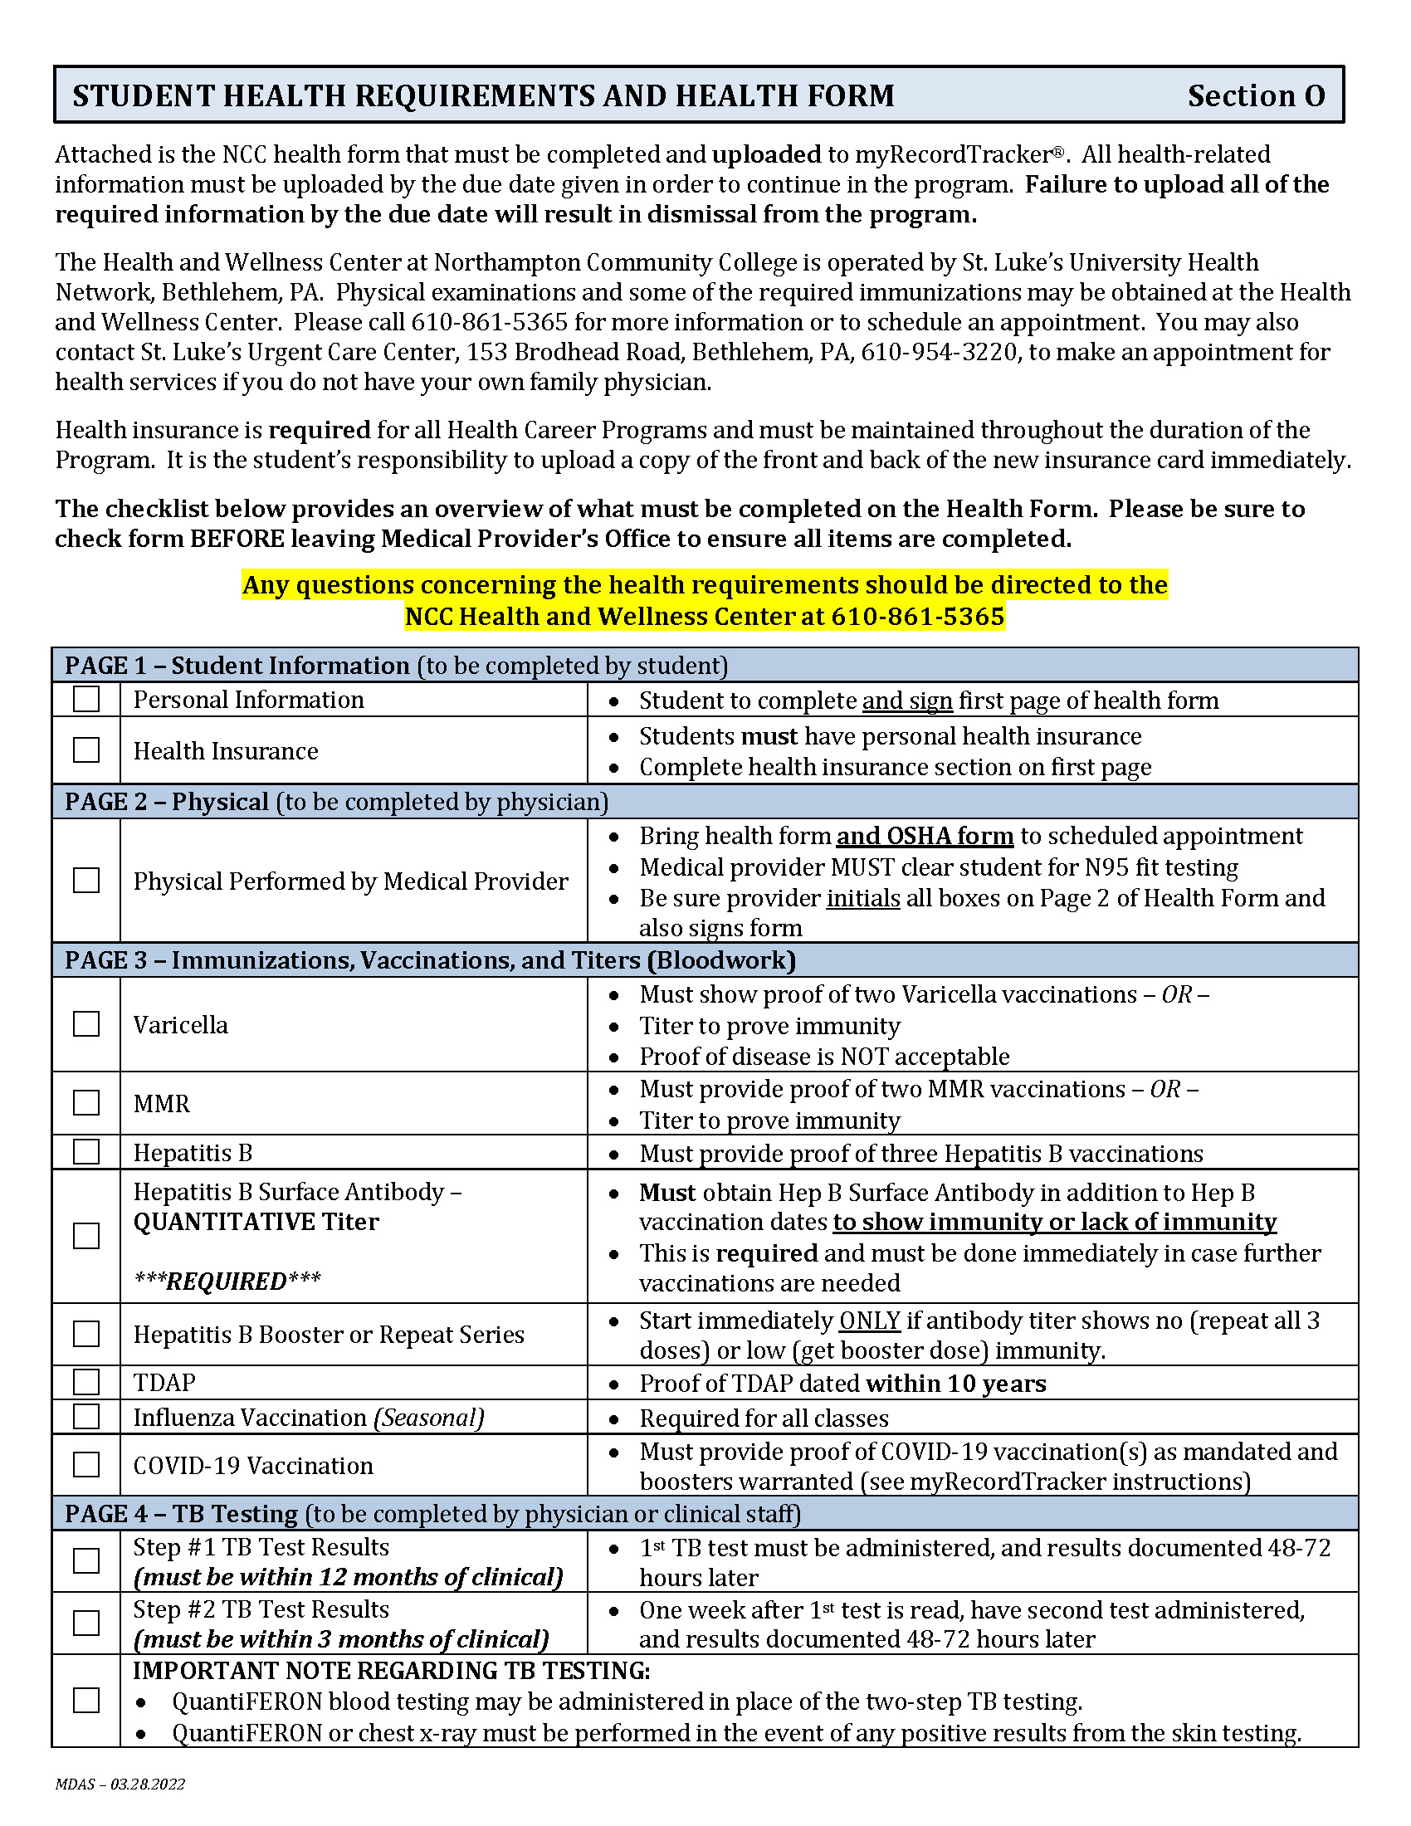
HEALTH REQUIREMENTS
Health Requirements Checklist provided as a guide for completion of health form which includes breakdown of items needed on each page
Pay attention to notes which indicate important points for completion of each requirement
Flu vaccinations and urine drug screen have different due dates

Slide 13
HEALTH REQUIREMENTS
Supporting documentation must be provided for all immunizations and titers, which include:
    Immunization Records
    Lab Reports for Titers
Completed health form including supporting documentation will be uploaded to your account at myRecordTracker.com

Slide 14
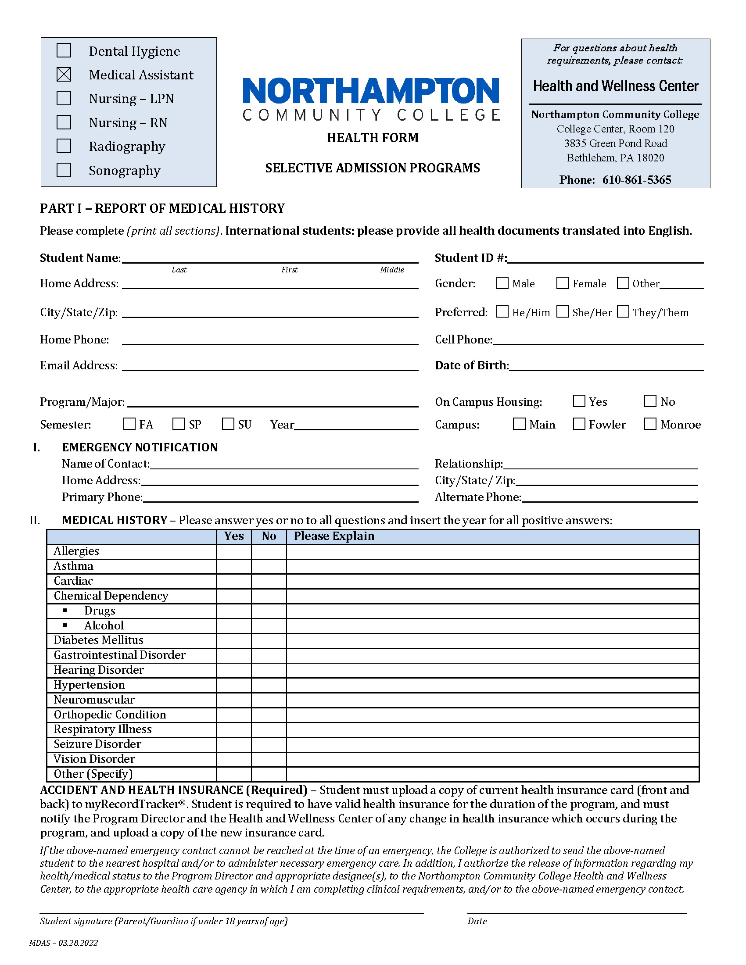
HEALTH FORM – PAGE 1
To be completed by student
List all health information
Must have valid health insurance throughout duration of the program
Sign and date where indicated

Slide 15
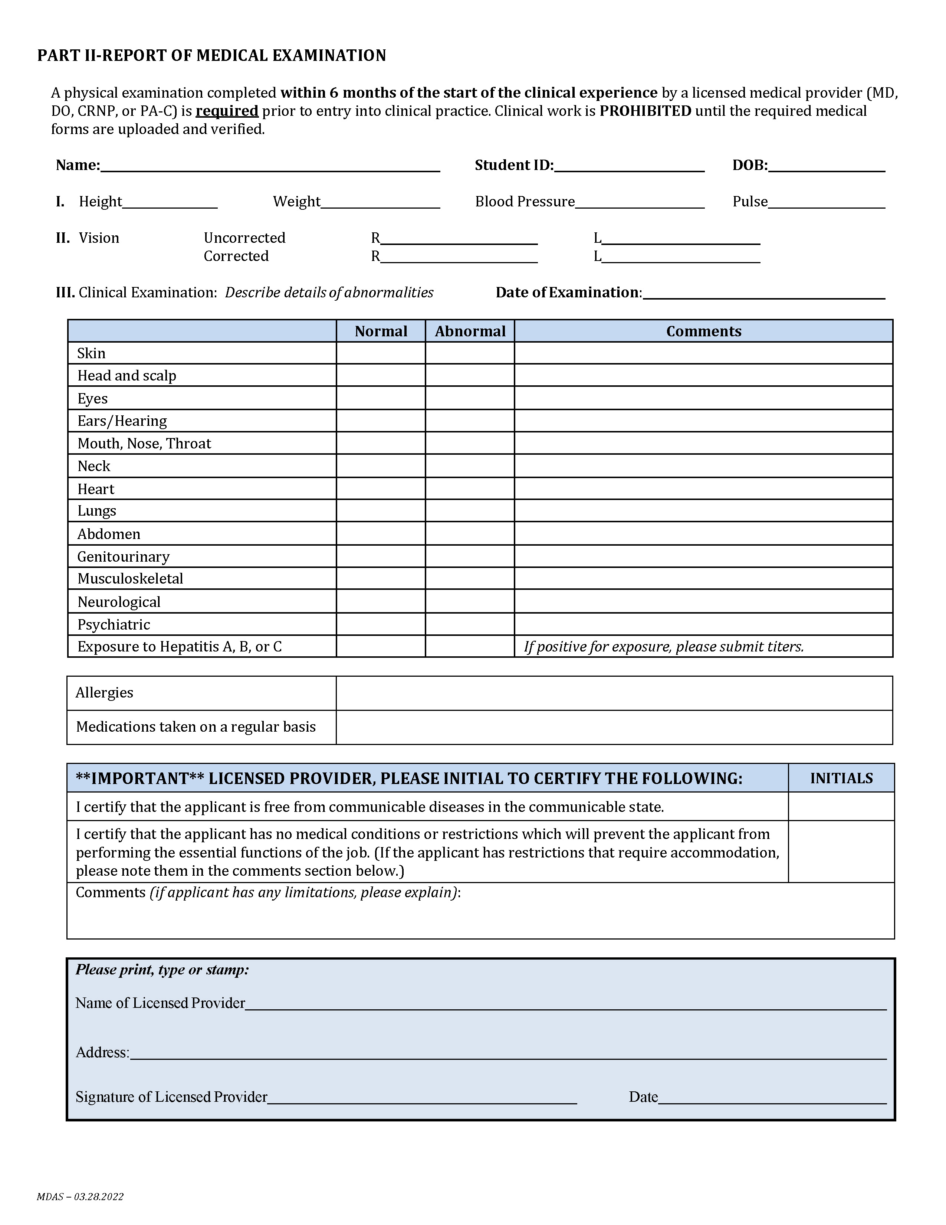
HEALTH FORM – PAGE 2
Bring completed OSHA Form to appointment
Exam must be completed by MD, DO, PA, or CRNP
Check boxes must be checked and initialed by medical provider
Medical provider must complete, sign and date bottom of form

Slide 16
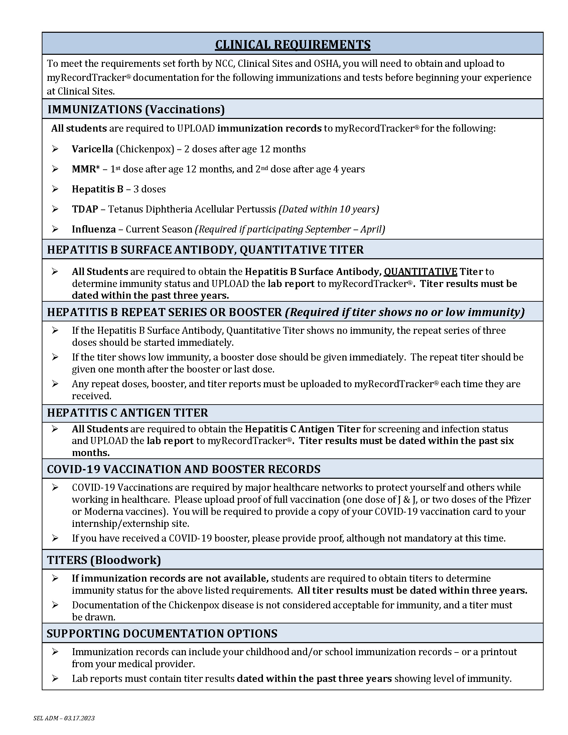
HEALTH FORM – PAGE 3
Lists required immunizations and titers
    2 Varicella doses – or – positive titer
    2 MMR doses – or – positive titers
    3 Hepatitis B doses
    Hepatitis B Surface Antibody, Quantitative*
    Additional Hepatitis B booster or series needed IF no or low immunity levels are present
    Hepatitis C Antigen Titer
    TDAP (dated within 10 years)
    COVID-19 Vaccination (fully vaccinated and boostered)
    Current Season Flu Vaccination
* ALL students are REQUIRED to obtain the Hepatitis B Surface Antibody titer even though they had the three original doses
MUST provide and UPLOAD immunization records and lab reports for all titers (dated within 3 years)

Slide 17
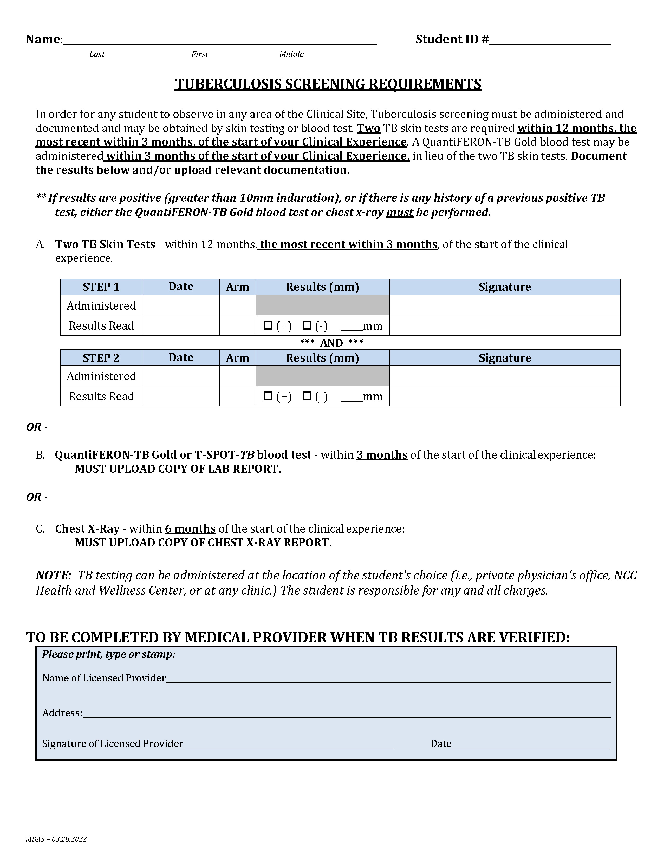
HEALTH FORM – PAGE 4
2 TB skin tests are required within 12 months, most recent within 3 months of clinical experience
Obtain 1st test; results read between 48-72 hours
One week after 1st test is read, 2nd test can be administered; results read between 48-72 hours
QuantiFERON®-TB Gold blood test may be done instead of skin testing
If skin test results are positive, the QuantiFERON®-TB Gold blood test or chest x-ray must be performed

Slide 18
Options for Vaccines/Titers/Physical Exams
St. Luke’s offers services at discounted pricing to NCC students at:
  The Health and Wellness Center in College Center 120
  St. Luke’s North on Broadhead Road in Bethlehem
Services payable by cash or check (payable to St. Luke’s) only
NCC Health & Wellness Center Main Campus ♦ College Center ♦ Room 120 3835 Green Pond Road ♦ Bethlehem, PA 18020 Phone: 610-861-5365 ♦ Fax: 610-861-4545
NCC Health & Wellness Center Physical Exam and Health Requirement Options
Physical Exams | $25.00 (by appointment only at the Health & Wellness Center) | $45.00 (at St. Luke’s North*)
Required Vaccines/Titers
IMMUNIZATION | VACCINE PRICES | TITER PRICES
 | Available at both the Health & Wellness Center and St. Luke’s North* | Available at St. Luke’s North* only
Hepatitis A (per dose) | $65.00 (2 doses needed)
Hepatitis B (per dose) | $60.00 (3 doses needed) | $30.00
Meningitis (Menactra) | $130.00
MMR (per dose) | $70.00 (2 doses needed) | $219.50 (for all 3 titers)
Tetanus (Tdap) | $40.00 (includes pertussis)
Tuberculin Skin Test (PPD) | $10.00 (per test)
Varicella | $135.00 | $42.60

Slide 19
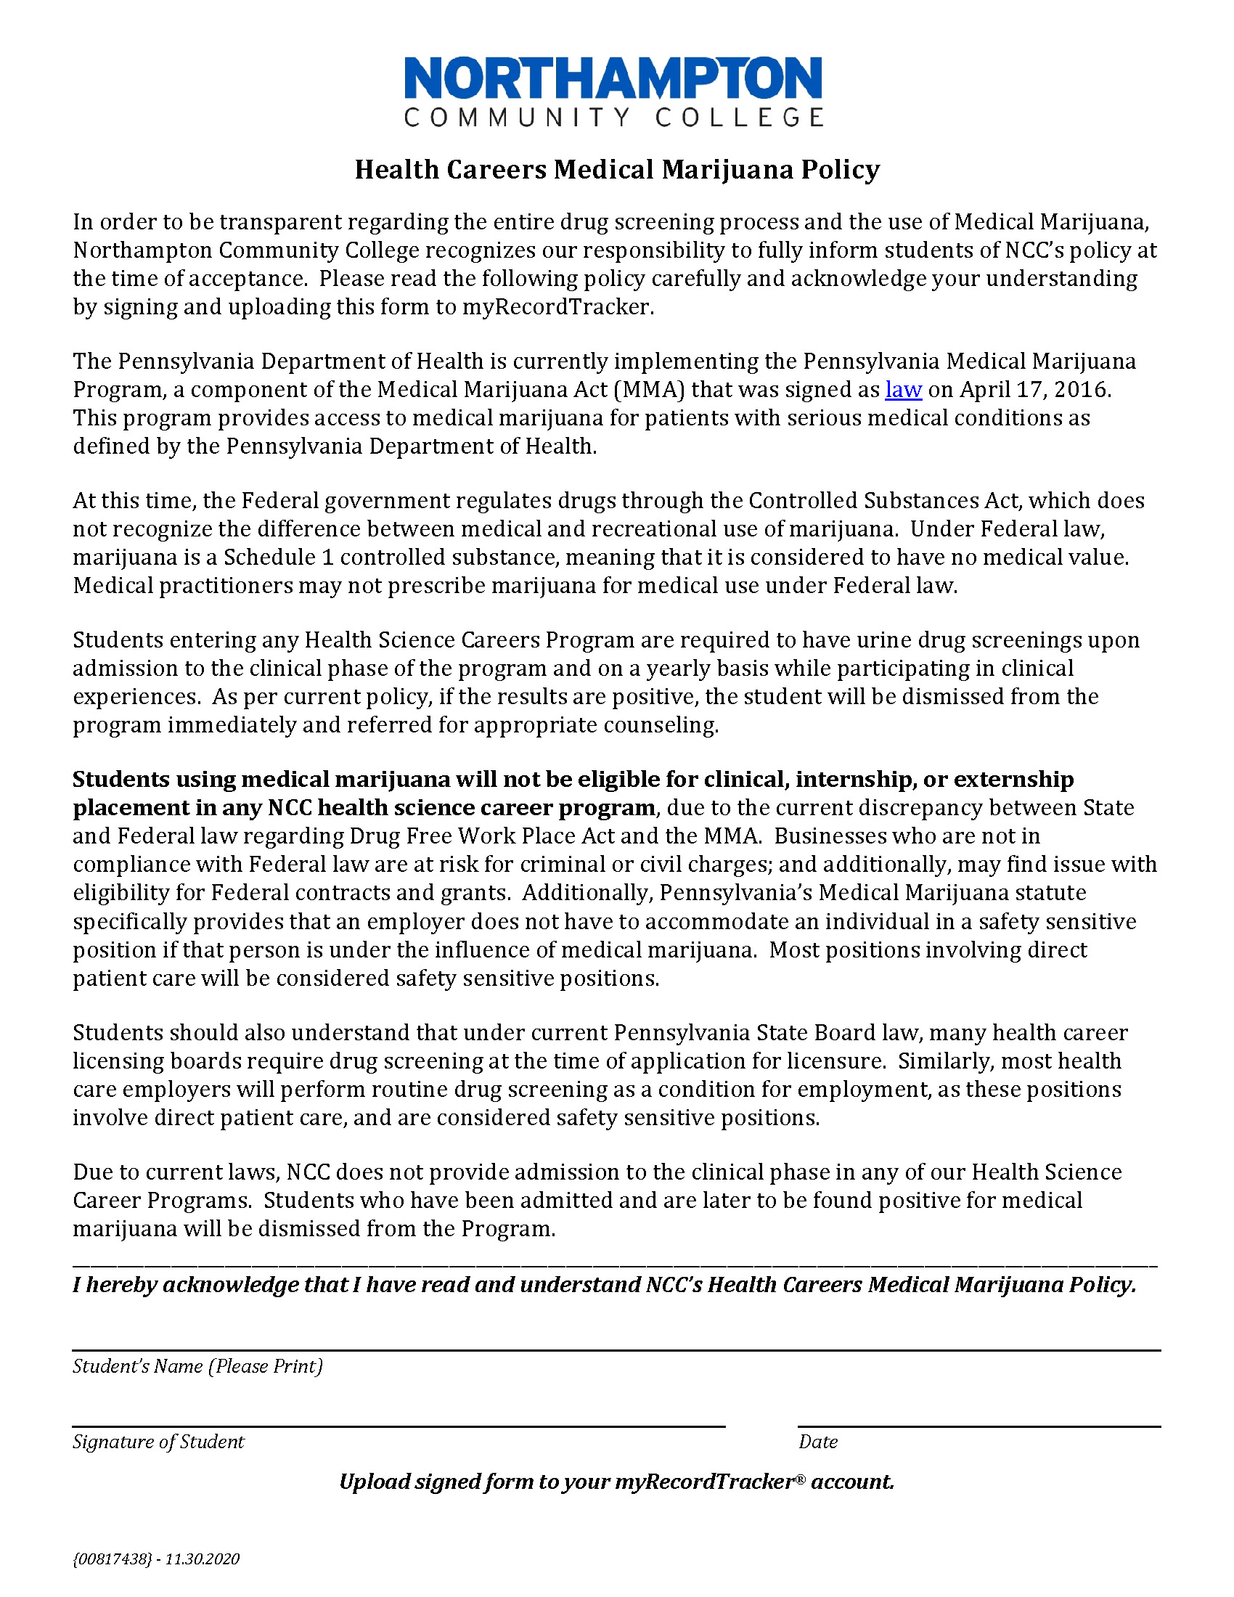
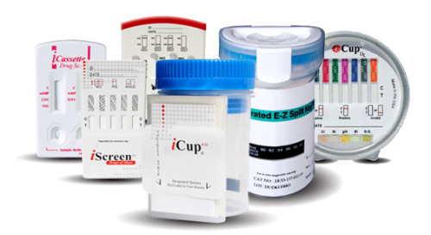
DRUG SCREEN PROCESS
DO NOT DO NOW!
Urine Drug Screen Test
Read, Sign, and Upload Medical Marijuana Policy
Instructions given in class and/or sent by email
Only 24 hours notice may be given
Be sure to bring payment and a photo ID
Payment will be approximately $34 and will be payable at time of drug screen

Slide 20


UPLOADING DOCUMENTS
Upload background clearances prior to submitting original documents to Program Director, if required
Documents may be uploaded by simply taking a picture with a smart phone or tablet
Must upload entire pages (no partial pages)
A laptop and scanner are available for student use at the Health Center:
College Center, Room 120

Slide 21

Regarding myRecordTracker®, contact Certiphi at 800-369-2612, ext. 2006
Regarding your STUDENT email, contact Helpdesk at 610-861-5413
Regarding your health requirements, contact the Health Center at 610-861-5365
Regarding your program requirements, contact your Program Director
Jaye Brennan at jpbrennan@northampton.edu

Slide 22


Slide 23

Good Luck with your program!

